Slide 1
Cogniplant
HOE Training
June 2023
Elisabeth Tchouakou Tatchi und Georgios Chasparis (SCCH)

Slide 2
Introduction to Cogniplant

Slide 3
HOE Training
Challenge
June 2023
Shortage in raw materials, increased energy prices and environmental constraints require the EU process industry to improve its performance and flexibility, and therefore increase efficiency.
In this situation there are unexploited opportunities for digitising a large range of enterprises of very different size in the process industry.

Slide 4
Ambition
HOE Training
June 2023
Digitalization in the European process industry
Digital retrofitting
Collecting and structuring data from sensors and equipment for its further analysis
Advanced data analytics: Big data, Process mining, Machine learning models of prediction & optimization
Development and use of digital twin
Cognitive Reasoning and Reactive scheduling

Slide 5
Key figures
HOE Training
June 2023
1 Application domain: Industries with high consume of energy
4 Uses cases (Mining, Metal, Quicklime, Chemical)
14 partners
8 countries: ES,GR, IE, NL, IT, AT, DE, FR
Total budget: 8.6 M€
Requested grant: 6.7 M €
Duration: 42 months

Slide 6
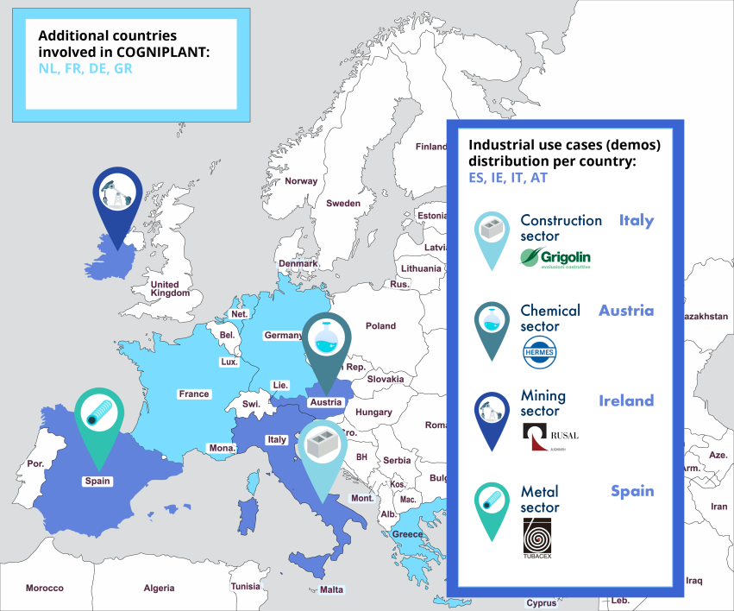
HOE Training
Consortium
June 2023

Slide 7
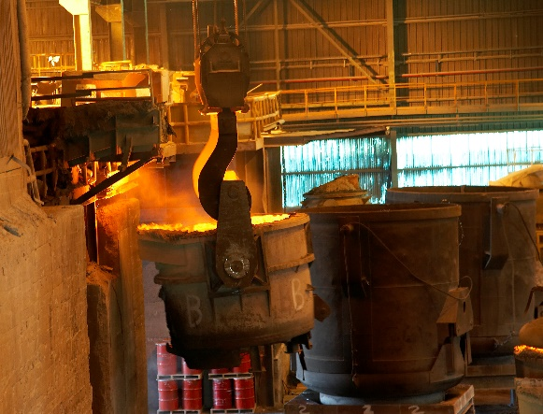

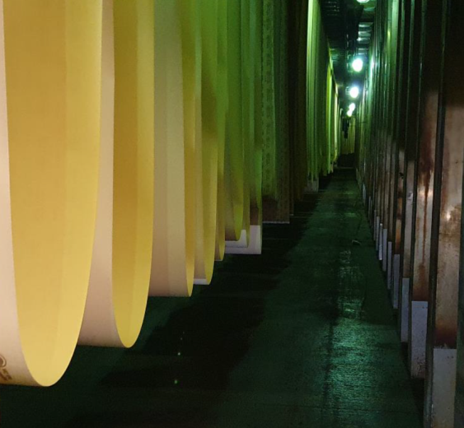
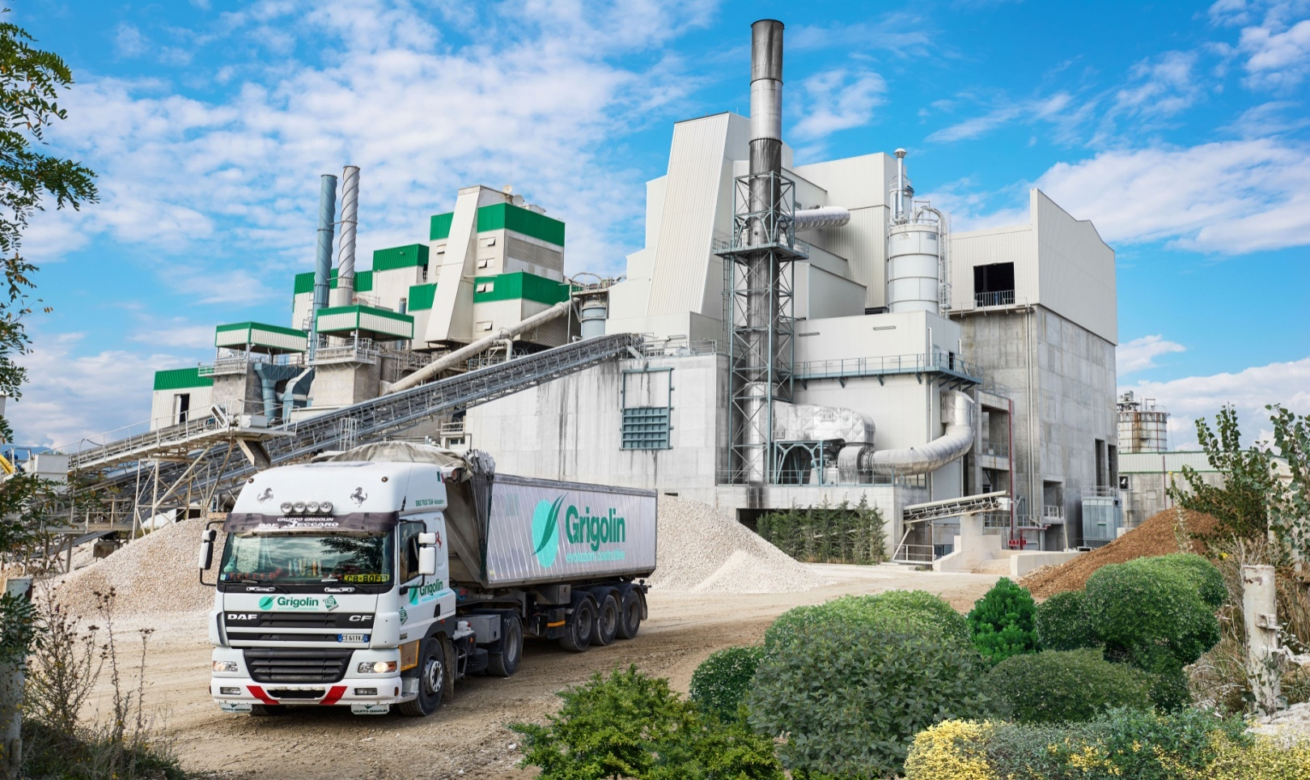
Industrial Consortium
HOE Training
June 2023
Energy consumption
CO2 Emisions
Quality

Slide 8
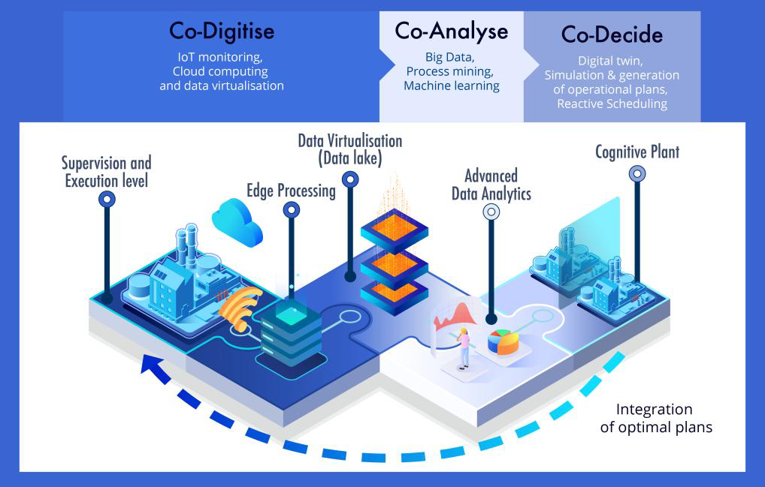
Concept
HOE Training
June 2023
Notes:
The COGNIPLANT solution will provide a hierarchical monitoring and supervisory control that will give a comprehensive vision of the plants’ production performance as well as the energy and resource consumption

Slide 9
Goals
HOE Training
June 2023
Actual Situation
Requirement of different target industries and productions systems.
Expert’s knowledge and insights to define the solution.
Definition of the KPIs and establishment of the baseline of the target use cases.
Solution Architecture Framework.
Monitoring system.
Enhancing the data acquisition system by means of new sensors and virtual sensors.
Development a strong edge node for processing and management of real time multiple data streams.
Development of the cloud based real time data system to manage the information
Development of the data virtualisation platform, to store the information in a structured way.
Big data
Process mining tool in combination with inference-based modelling framework.
Online prediction framework in combination with an analytics dashboard for performance prediction and optimization support

Slide 10
Goals
HOE Training
June 2023
Cognitive Plant
Integrating the different layers to create the Cognitive platform..
Modelling the targeted demonstration cases by means of the Digital Twins .
Development of the Co-Decide module for decision support.
Developing Reactive scheduling modules to deal with dynamic changing production conditions
Real use cases
Digitisation of the production plants
Optimization of data acquisition, communication and automation, achieving the digital retrofitting of existing assets.
Implementing the COGNIPLANT’s overall solution in production plants of 4 different SPIRE industries.
Monitoring of the demonstrators and validation of approach through the monitoring of the KPIs.

Slide 11
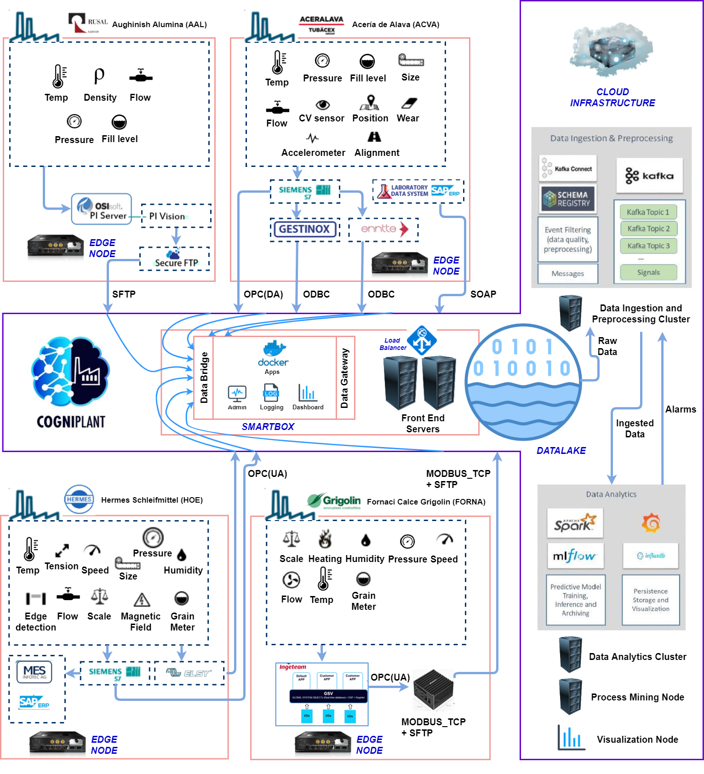

Cogniplant Deployment
HOE Training
June 2023
11
This project has received funding from the European Union’s Horizon 2020 research and innovation programme under grant agreement No 869931

Slide 12












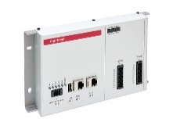






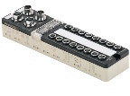



HOE Training
June 2023
Data gathering
USE CASE LOCATIONS
CLOUD
PRODUCTION EQUIPMENT
EXISTING / ADDITIONAL SENSORS
EXISTING CONTROLLERS
EDGE PROCESSING (PAC)
DATA GATEWAY (SMARTBOX)
DATA FRONTEND SERVERS
CLOUD DATALAKE

Slide 13
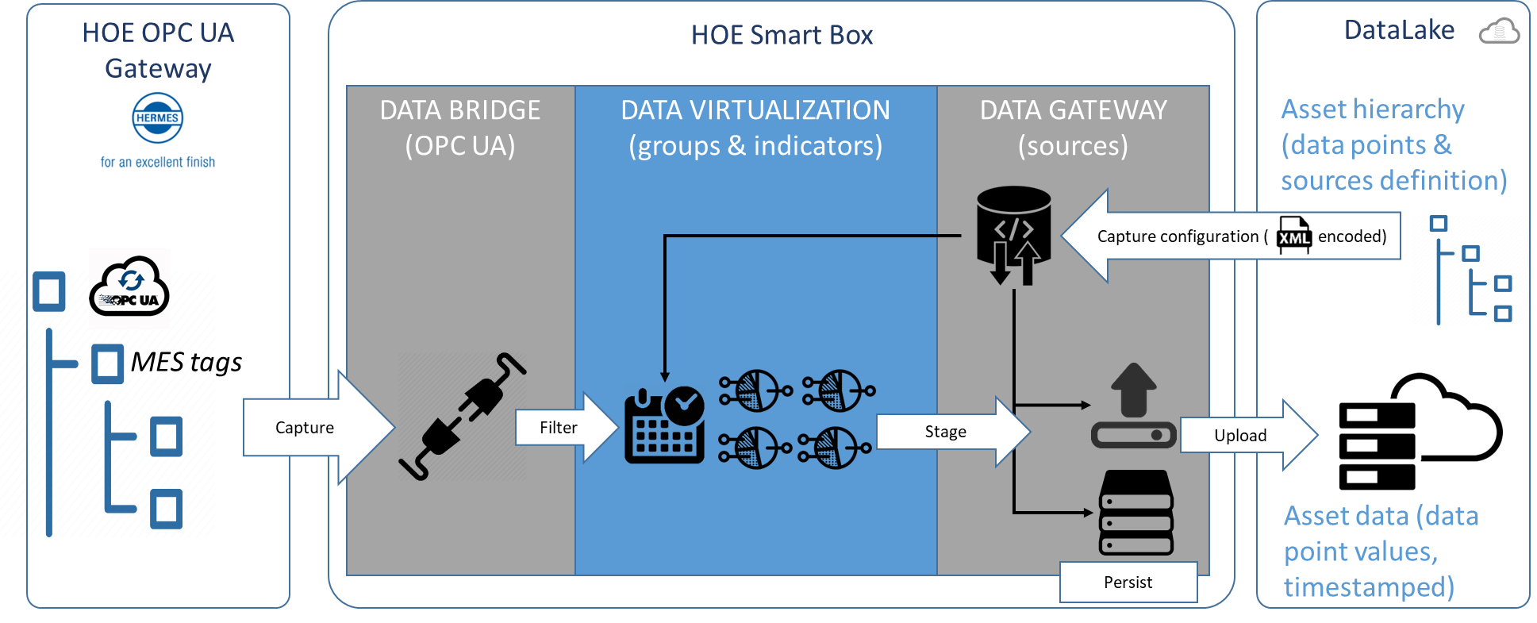

HOE Training
June 2023
Data gathering
  Live dataflows: M2C

Slide 14
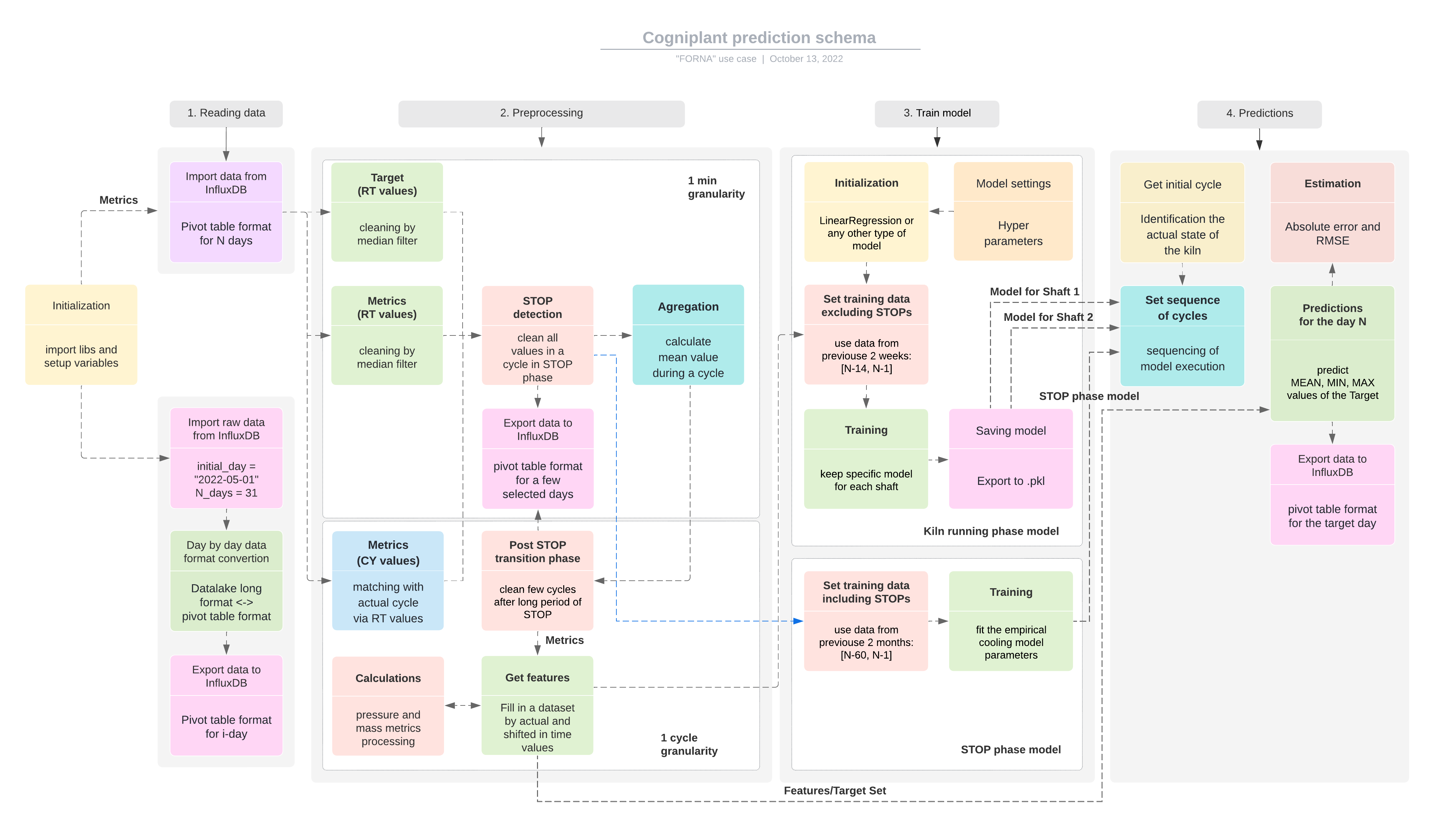
HOE Training
June 2023
Data Preprocessing

Slide 15
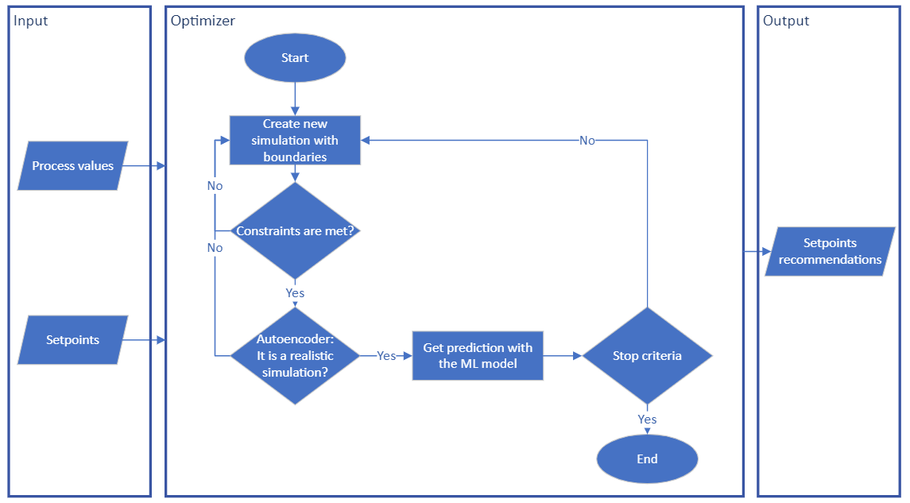
Digital Twin : Optimizer
HOE Training
June 2023
The optimization model is the core of the digital twin and consists of three elements:
  The objective function/s: can be function/s or data model/s trained.
  Variables:
    Input: current process values and setpoint ➔ define the state of the process.
    Output: setpoints recommendation.
  Constraints:
    Variables bounds.
    Business constraints: can be predictive models or other constrains.
    Autoencoder: model that discards unrealistic scenarios.
T4.2. Co-Decide: a new Digital Twin Paradigm
T4.2. Co-Decide: a new Digital Twin Paradigm
Notes:
The optimization model is the core of the digital twin and consists of three elements:
The objective function: can be a defined function or a data model trained in WP3 from the historical data. In this case the model developed in WP3 is used to predict the steam consumption in the digestion area.
Variables:
the process values together with the current setpoint values are the input variables that define the state of the process.
The setpoints are the variables to be recommended in order to optimize the process. ➔ output
Constraints: on the one hand, business constraints and, on the other hand, a model that discards unrealistic scenarios (autoencoder). Business constraints can also be predictive models based on data developed in WP3 in order to avoid undesirable future scenarios. For now, we only work with the model that discards unrealistic scenarios.
The optimizer captures in real time the state of the industrial process to be optimized.
The process values together with the current setpoint values are the variables that define the state.
The final objective of the model is to recommend new setpoint combinations in order to optimize the process.
To this end, new scenarios are simulated respecting the upper and lower limits of the variables, the constraints and the threshold set with the autoencoder.
The results are then obtained with the objective function. This is an iterative process that is repeated until the set stop criterion is met.
Once finished, the optimal setpoint combination is returned as a recommendation.

Slide 16
Introduction to HOE Use-Case

Slide 17
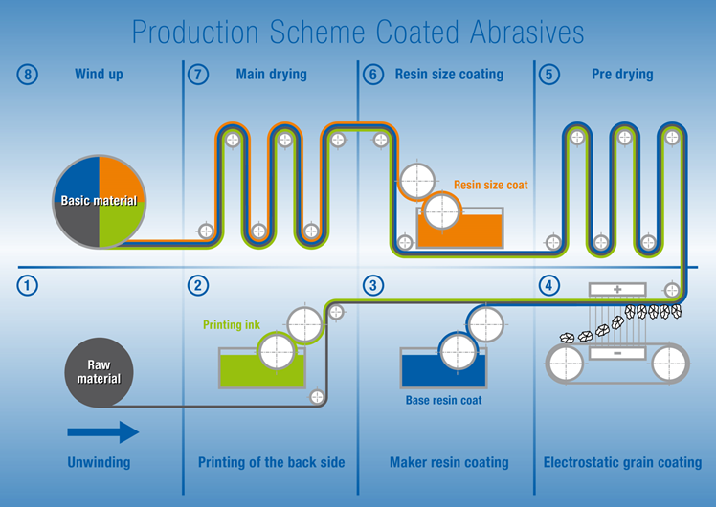
HOE Training
June 2023
Use-case description
Production of Coated Abrasives
  Comprising:
    Unwinding
    Base (Resin) Coating
    Electrostatic Grain Coating
    Pre-drying
    Resin Size Coating
    Main drying
    Winding up
Focus on quality regulation
  Base (Resin) Coating (BC)
  Electrostatic Grain Coating (EGC)
Remarks
  Elsy-scanners measure quality after BC and EGC in near real-time (frequency of 1min)

Slide 18
HOE Training
June 2023
Index | KPI | Sub-KPI | Feasibility | Impact of Predictive Modeling | Notes
H-KPI-1 | Specific Energy Consumption | Heat-up times | Not possible to target | Not applicable | Fuel source has changed.
H-KPI-2 | Specific Energy Consumption | Schedules of Auftrags/Types | Not possible to target | Not applicable | Unknown constraints
H-KPI-3 | Production Stops |  | Targeted, indirectly through the regulation of quality deviations | Reduction of stops by predicting and regulating quality | Generic production stops cannot be targeted due to absence of data
H-KPI-4 | Scrap Material | Reduce scrap material generated due to missed specifications in KORN | Targeted, indirectly through the regulation of quality deviations | Reduction of scrap material by predicting and regulating quality
H-KPI-5 | Scrap Material | In which process step(s) is most of the scrap material produced? | Not targeted. Priority has been given to H-KPI-4 | Not applicable | The KORN step (of H-KPI-4) has been identified as the main source of scrap material by the HOE’s experts.
H-KPI-6 | Quality | Predicting quality in intermediate production steps | Targeted | Improving quality standards by predicting and regulating quality
Feasibility Analysis
Feasible KPIs to target
  H-KPI-3 Production Stops
  H-KPI-4 Scrap Material
  H-KPI-6 Quality (Main KPI)
Impact
  Increased product quality
  Increased energy efficiency
  Reduced scrap material
  Increased resource efficiency
Remarks
  A-KPI-1/2 cannot be targeted due to technical reasons
  Energy consumption is indirectly targeted through H-KPI-3/4/6

Slide 19
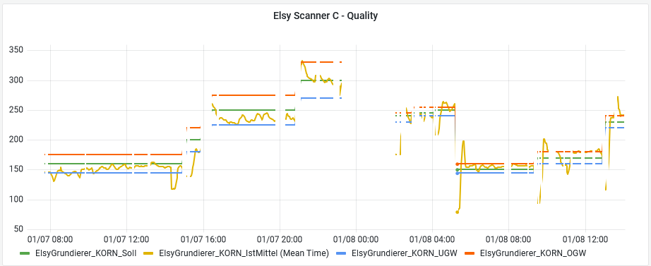
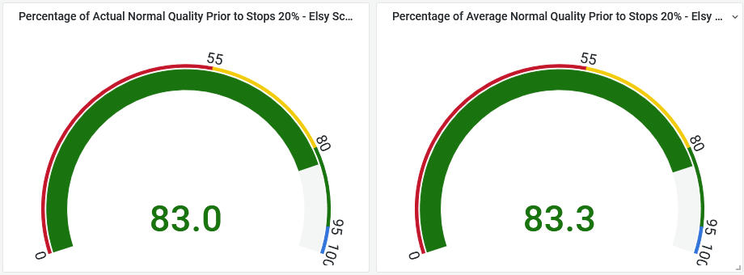
HOE Training
June 2023
Typical quality variations
Production Stops & Scrap
Goal & Challenges
  Predict extreme quality deviations (associated to stops)
  Compute better configuration of setpoints
  Reduce stops/scrap through quality deviations
Impact & Analysis
  By better regulating quality, we reduce stops/scrap
  ~17% of times quality was abnormal before a stop
  1% reduction in stops corresponds to 40k €/year
  Reduce number of stops through improving quality
  Main target: reduce quality variation
Statistics of normal quality prior to stops

Slide 20
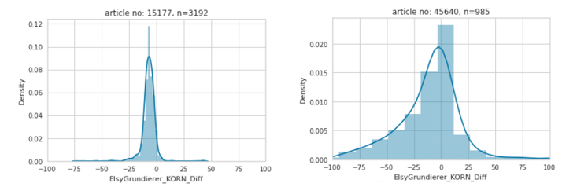
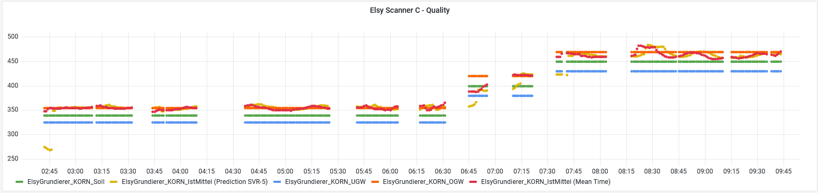
HOE Training
June 2023
Variation of quality measurements per order and product type (TUM)
Quality Regulation
Goal & Challenges
  Monitor/Predict product quality
  Large # of product types
  Variations of quality per type
Impact
  Reduce quality variations
  Increase energy/resource efficiency
Analysis
  Data Preprocessing and restructuring
  Analysis based on higher-order temporal features (SCCH)
  Analysis based on running meter and gradient boosting (TUM)
Sample predictions using SVR for 5-min ahead quality predictions (SCCH)

Slide 21
Predictive Modeling (SCCH)

Slide 22
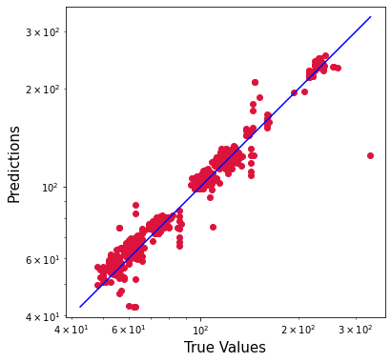
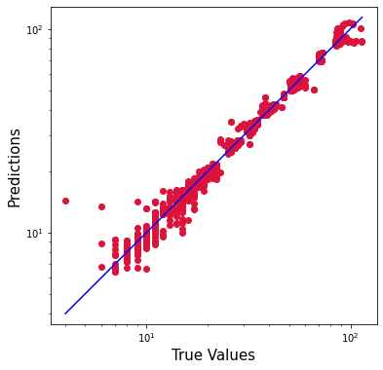
HOE Training
June 2023
Models | Product Type 11400 (#data rows = 9026) |  | Product Type 45640 (#data rows = 1363) |  | Product Type 61810 (#samples = 12886)
 | R2 | MAPE (%) | R2 | MAPE | R2 | MAPE
LR-2-5-10 | 0.972 | 3.60 | n.a. | n.a. | 0.992 | 4.14
LR-5-10 | 0.949 | 6.70 | n.a. | n.a. | 0.986 | 3.83
SVR-2-5-10 | n.a. | n.a. | n.a. | n.a. | 0.766 | 26.0
SVR-5-10 | n.a. | n.a. | n.a. | n.a. | 0.751 | 19.4
MLP-2-5-10 | 0.269 | 40.3 | n.a. | n.a. | 0.973 | 8.01
MLP-5-10 | n.a. | n.a. | n.a. | n.a. | 0.980 | 6.59
T3.3. Machine Learning
HOE
H-KPI-5 Quality
Analysis based on higher-order temporal features (SCCH)
  Data Preprocessing and Restructuring
  Standard linear regression
  Support vector machines
  Deep Neural Networks
  Multi-scenario Deep Neural Networks
Remarks
  Good performance by LR
  High accuracy of some types of products
Used for
  Digital Twin (T4.2) / Quality optimization (IBER)
  Reactive scheduler (T4.3) / Reactive quality regulation (SCCH)
 | Test Naive Model | Test Cogniplant Model | Improvement
nRMSE (5min-ahead point prediction – SCCH) | 0.00357 | 0.00161 | 54.90%

Slide 23
Predictive Modeling and Vorhersagemodell (TUM)

Slide 24



HOE Training
June 2023
Predictive Modeling: Model fitting process
input variables
model and pre-processing
Grundierer_PlattenabstandEinlauf
Grundierer_PlattenabstandAuslauf
Grundierer_StreutrichterStreuspalt
Grundierer_TrafoFrequenz
Grundierer_TrafoSpannung
Grundierer_TrafoStromstärke
ElsyGrundierer_GL_IstMittel
Grundierer_Kornfeuchte
standard scaler from scikit-learn (mean 0, variance 1)
XGBoost regression model with default parameters
! for each meter of the product !
$$y=f(x)$$
reduced data set
training data set
XGBoost regressor
2/3
training
target variable
ElsyGrundierer_KORN_IstMittel
1/3
test data set
prediction

Slide 25
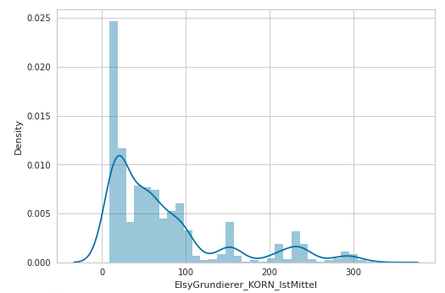
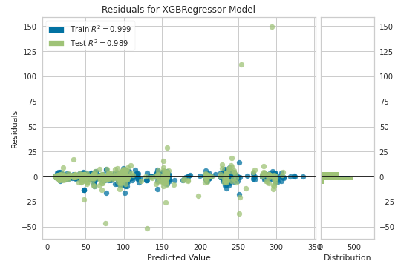
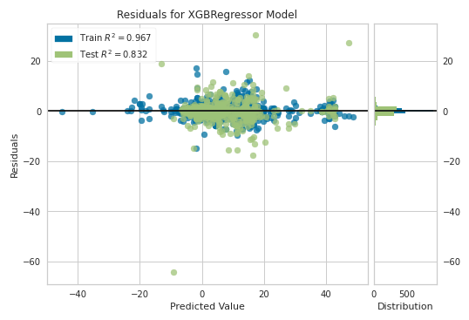
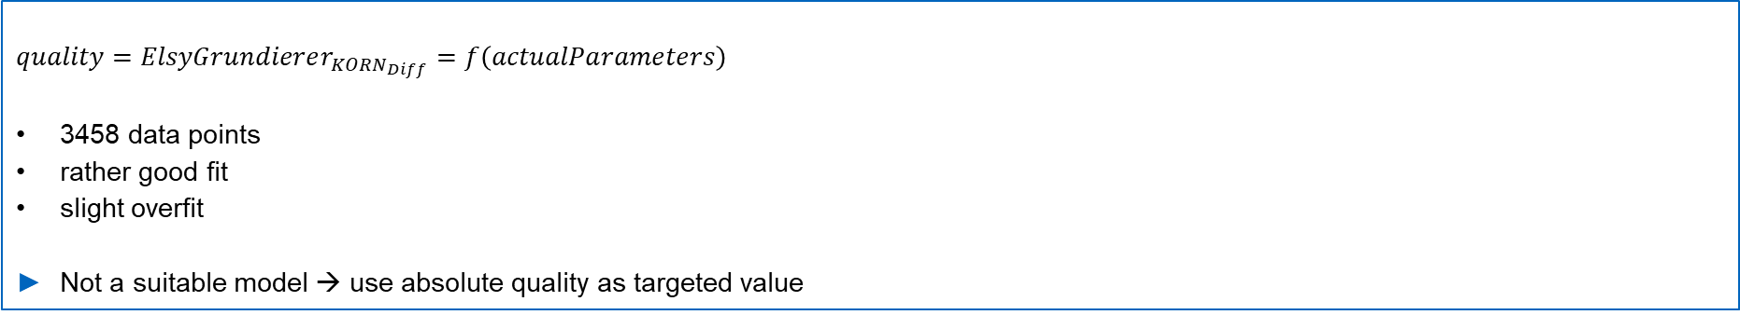
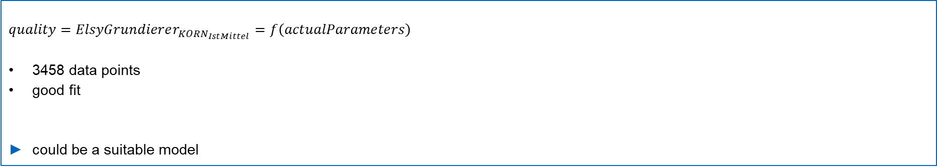
HOE Training
June 2023
Product 61810 all corn sizes
Absolute Quality
$$quality=ElsyGrundierer_{KORN_{IstMittel}}=f\left(actualParameters\right)$$
3458 data points
good fit
could be a suitable model
Relative Quality
$$quality=ElsyGrundierer_{KORN_{Diff}}=f\left(actualParameters\right)$$
3458 data points
rather good fit
slight overfit
Not a suitable model → use absolute quality as targeted value

Slide 26
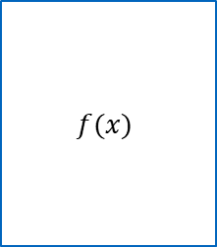
HOE Training
Juni 2023
Vorhersagemodell: Methode (TUM)
Schritt 1
Modellierung der Qualität auf Basis der Prozessparameter
Vorverarbeitung der Daten
im ersten Schritt muss ein passendes Modell gefunden werden.
Datenbasis: CogniPlant-Cloud
Beispielmodelle:
  datengetriebene Modelle
  Methoden des Maschinellen Lernens (ML)
Qualität vorheriger Prozessschritt
$$f(x)$$
Prozessparameter
Qualität
…
Auswertung und Empfehlung
Schritt 2
Sensitivitätsanalyse
erfordert ein gültiges Modell
Beispielhafte Methode:
  Sobol‘-Analyse
  Shapley-Werte
Qualität
vorheriger Prozessschritt
Prozessparameter 1
Prozessparameter 2
Einfluss →

Slide 27
HOE Training
Juni 2023
Prozess der Modellanpassung
Eingangsgrößen
Modell and Datenvorverarbeitung
Grundierer_PlattenabstandEinlauf
Grundierer_PlattenabstandAuslauf
Grundierer_StreutrichterStreuspalt
Grundierer_TrafoFrequenz
Grundierer_TrafoSpannung
Grundierer_TrafoStromstärke
ElsyGrundierer_GL_IstMittel
Grundierer_Kornfeuchte
Standard-Skalierer von scikit-learn (mean 0, variance 1)
XGBoost Regressionsmodell mit Standardparameter
! für jeden Meter des Produkts !
$$y=f(x)$$
reduziertes Datenset
Trainings-Daten
XGBoost regressor
2/3
Training
Zielgröße
ElsyGrundierer_KORN_IstMittel
1/3
Test-Daten
Vorhersage

Slide 28


HOE Training
June 2023
Produkt 61810 alle Korngrößen
Absolute Qualität
$$quality=ElsyGrundierer_{KORN_{IstMittel}}=f\left(actualParameters\right)$$
3458 data points
good fit
could be a suitable model
könnte ein passendes Modell sein
Relative Qualität
$$quality=ElsyGrundierer_{KORN_{Diff}}=f\left(actualParameters\right)$$
3458 data points
rather good fit
slight overfit
Not a suitable model → use absolute quality as targeted value
kein passendes Modell --> verwende absolute Qualität als Zielgröße

Slide 29
Quality Optimization (IBER)

Slide 30
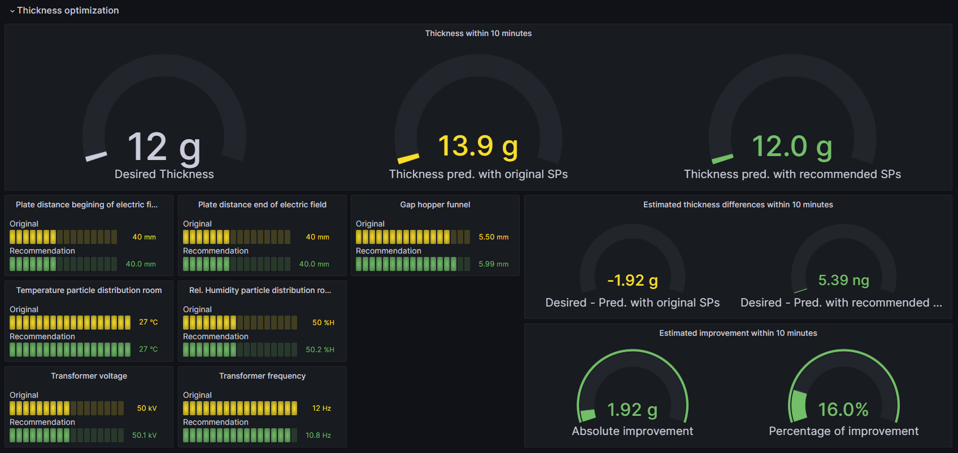
HOE Training
June 2023
Digital Twin
IBER
Goals
Relevant parameters
  Thickness of the product after the EGC step
Ultimate Goal
  Given a real plant scenario, to generate future recommendations of setpoints (SPs) to achieve the desired product thickness
Methodology
  A genetic algorithm has been used to optimize this case due to the need for exhaustive exploration of the search space and the presence of complex constraints
Notes:
Objective: Recommend the minimum consumption of TAP13 to maintain the temperature within the range (1580ºC- 1600ºC). For this purpose, a predictive model is created to predict the final temperature of a COLADA. The consumption of TAP13 is an input of the predictive model. Once the predictive model is trained, an optimizer is created to recommend the optimal TAP13 consumption to reach the target temperature.
First, a dataset is prepared for modeling. The following predictor variables are used:
Total scrap load.
Total load by scrap group: group A, group F, group G.
Temperature measurement before applying TAP13.
Measurement of KWH consumed before applying TAP13.
KWH to be applied with TAP13: setpoint, variable to be recommended in the optimizer.
Since there is a significant relationship and loads are the only variables related to steel grade, new variables are created for each steel grade using leave-one-out encoding technique:
Load averages are created for each steel grade.
Averages of the target variable are created for each steel grade.
Estimating variables of the target variable are created (with a rule of 3) for each steel grade.
df_data['tap_13_consumo'][idx_row] * df_aux['temperatura_delta'].mean() / df_aux['tap_13_consumo'].mean()
An XGBoost model is used to model temperature and the optimal subset of variables is selected using RFE.

Slide 31
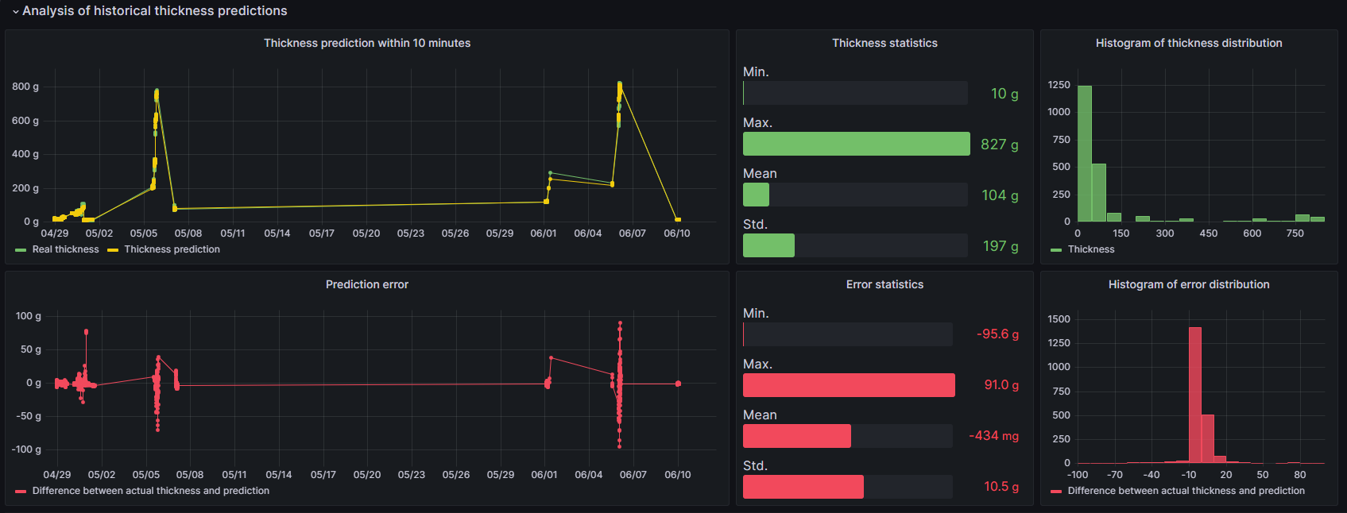
HOE Training
June 2023
Digital Twin
IBER
Development Description
Objective function
  The linear regression model for predicting product thickness with a 10-minute horizon, presented in WP3, is improved. An SVR model with a linear kernel is used, which shows superior results when validating the model with a 5-fold TimeSeriesSplit
Train
  5-TimeSeriesSplit RMSE = 11.52, 5-TimeSeriesSplit R2 = 0.93
Test
  RMSE= 10.49, R2 = 1
Notes:
Objective: Recommend the minimum consumption of TAP13 to maintain the temperature within the range (1580ºC- 1600ºC). For this purpose, a predictive model is created to predict the final temperature of a COLADA. The consumption of TAP13 is an input of the predictive model. Once the predictive model is trained, an optimizer is created to recommend the optimal TAP13 consumption to reach the target temperature.
First, a dataset is prepared for modeling. The following predictor variables are used:
Total scrap load.
Total load by scrap group: group A, group F, group G.
Temperature measurement before applying TAP13.
Measurement of KWH consumed before applying TAP13.
KWH to be applied with TAP13: setpoint, variable to be recommended in the optimizer.
Since there is a significant relationship and loads are the only variables related to steel grade, new variables are created for each steel grade using leave-one-out encoding technique:
Load averages are created for each steel grade.
Averages of the target variable are created for each steel grade.
Estimating variables of the target variable are created (with a rule of 3) for each steel grade.
df_data['tap_13_consumo'][idx_row] * df_aux['temperatura_delta'].mean() / df_aux['tap_13_consumo'].mean()
An XGBoost model is used to model temperature and the optimal subset of variables is selected using RFE.

Slide 32
Quality Reactive Optimization (SCCH)

Slide 33
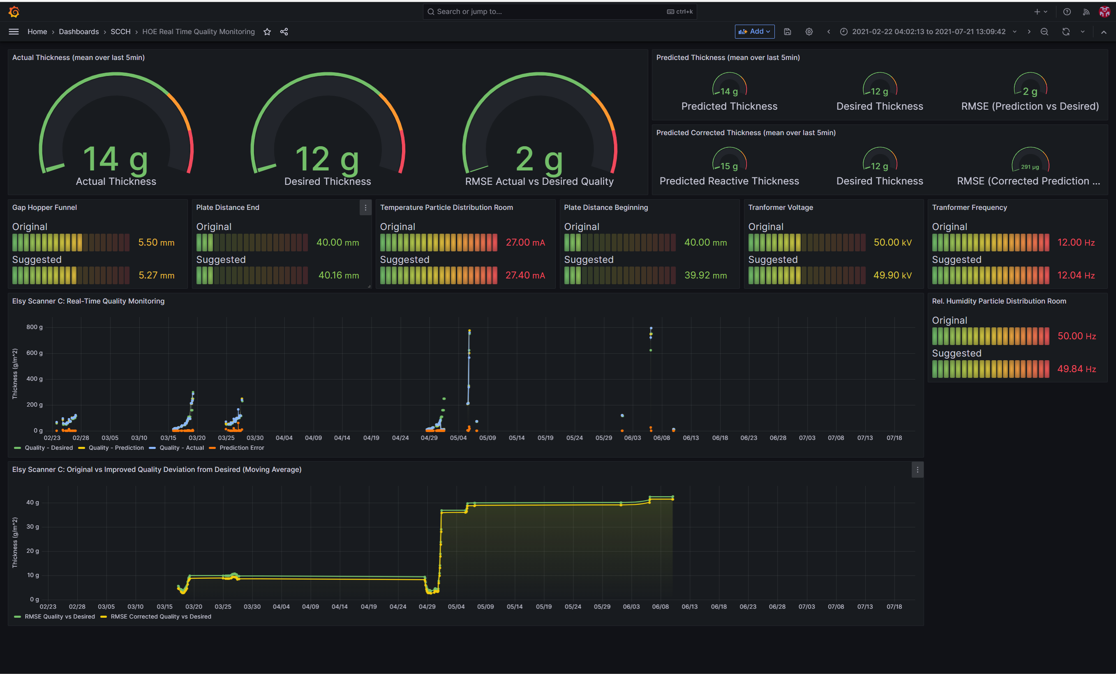
HOE Training
June 2023
Reactive Optimization
T4.3. Reactive Scheduling
Reactive optimizer (SCCH)
  Utilizes short-term predictions of quality
  Stochastic local-search optimization over configuration alternatives
  Estimated performance improvement to ~ 5%
~5% improvement in quality regulation!

Slide 34
Dashboards: Historical Data (SCCH)

Slide 35
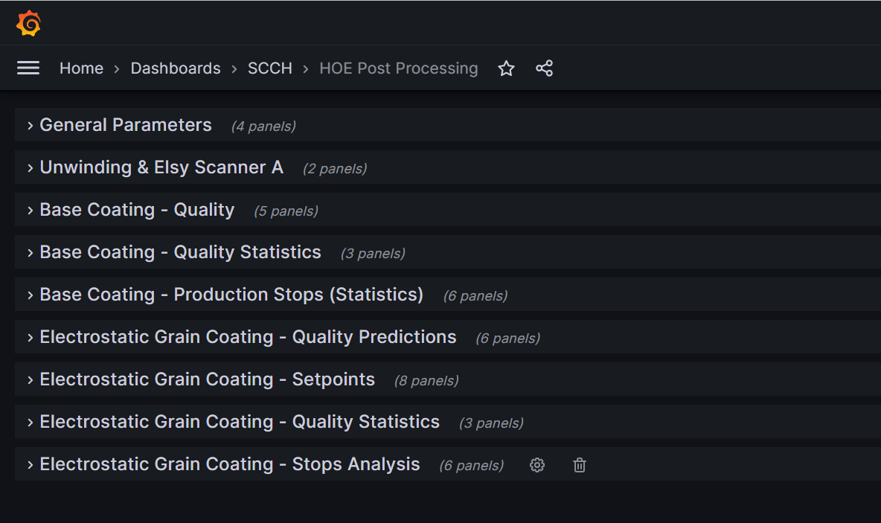
HOE Training
June 2023
Analytical Dashboards
T3.4. Dashboards
Analytic Dashboards
  Currently based on Grafana
  Visualizing historical and statistical data
  Visualizing predictions over quality
  Visualizing real-time data
Different types of dashboards
  Historical Data & Statistics
  Real-time Quality Predictions Monitoring
  Real-time Reactive Optimization Monitoring

Slide 36
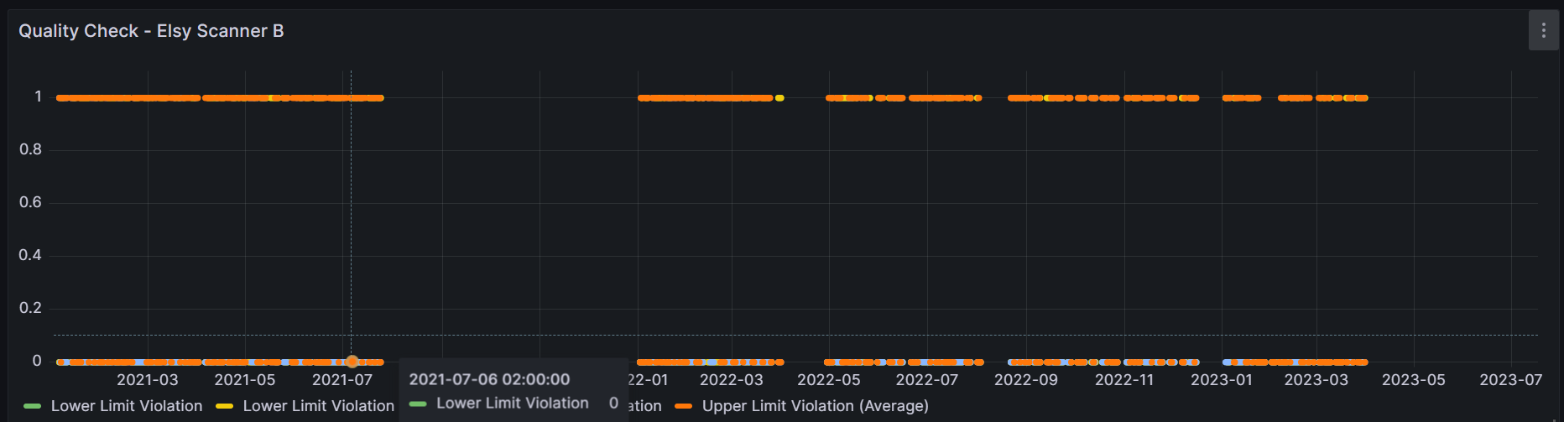
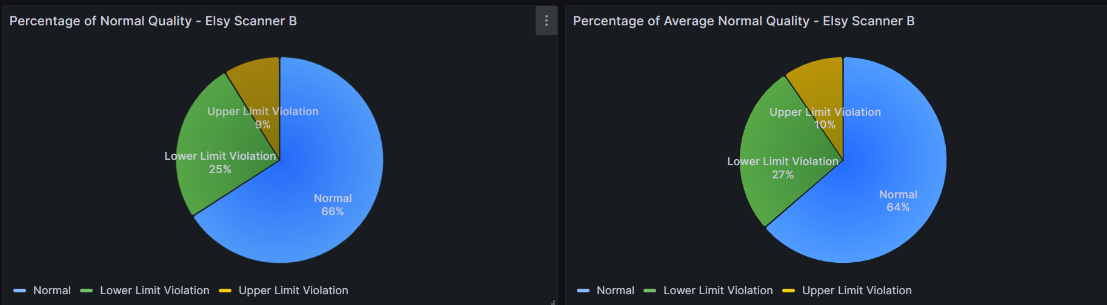
HOE Training
June 2023
Quality Performance Statistics
Quality Performance Monitoring & Statistics
  Continuous tracking of quality performance
  Indicators of low- and upper-threshold violations
  Calculating statistics over historical performances

Slide 37
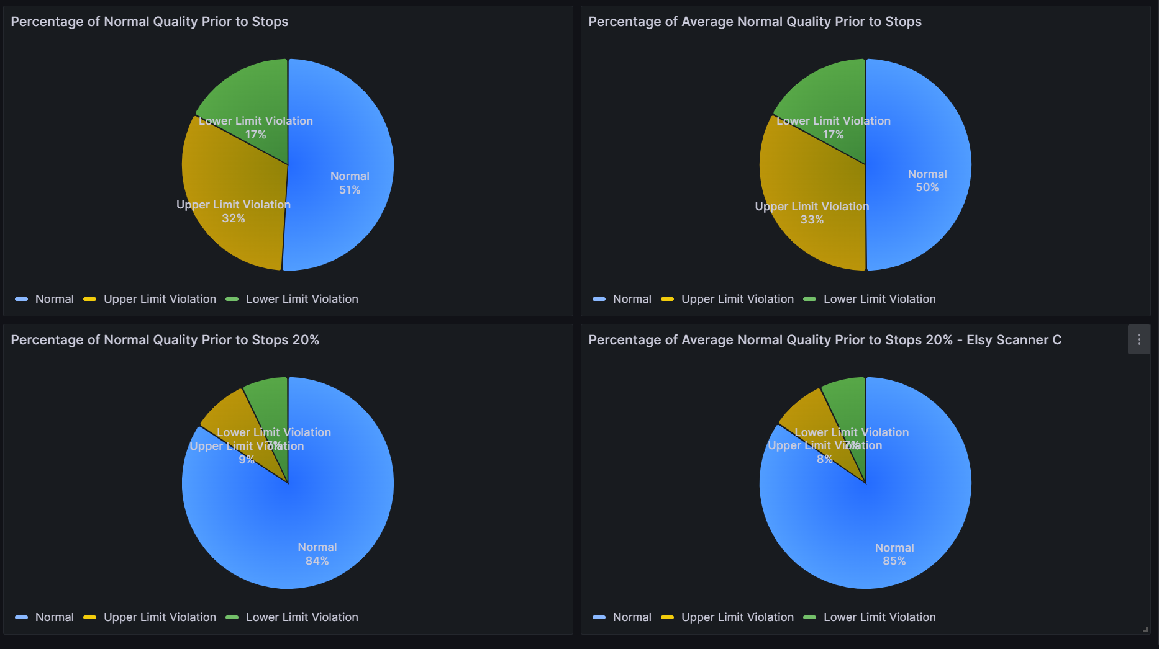
HOE Training
June 2023
Quality Performance Statistics prior to Stops
Quality Performance Monitoring prior to Stops
  Monitoring performance prior to production stops
  Indicators of low- and upper-threshold violations
  Indicators of violations of extended thresholds
  Calculating statistics over historical performances

Slide 38
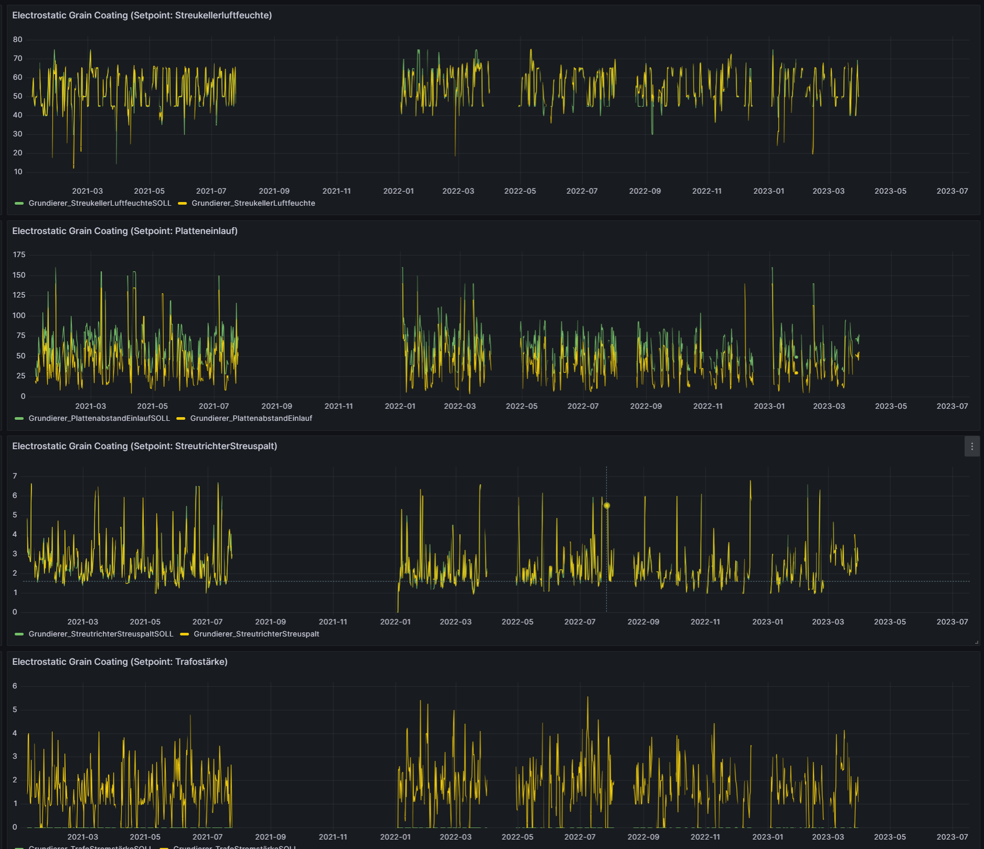
HOE Training
June 2023
Setpoints / Control Parameters Monitoring
Setpoints / Control Parameters Monitoring
  Continuous monitoring of Base Coating and Electrostatic Grain Coating setpoints/control parameters

Slide 39
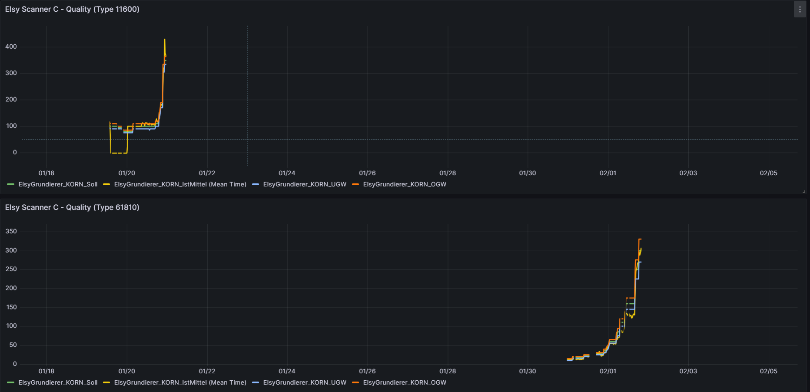
HOE Training
June 2023
Quality Monitoring
Quality Monitoring
  Continuous monitoring of Base Coating and Electrostatic Grain Coating quality performance
  Visualizations can be filtered based on Auftrag / Type / Fabrication / Rolle

Slide 40
HOE Training
June 2023
Reactive Optimization Monitoring
Reactive Optimization Monitoring
  Real-time quality and predictions monitoring
  Predictions are computed over the next 5min
  Recommendations are provided over the setpoints configuration
  Monitoring of overall performance improvement

Slide 41
Dashboards: Real time (SCCH)

Slide 42
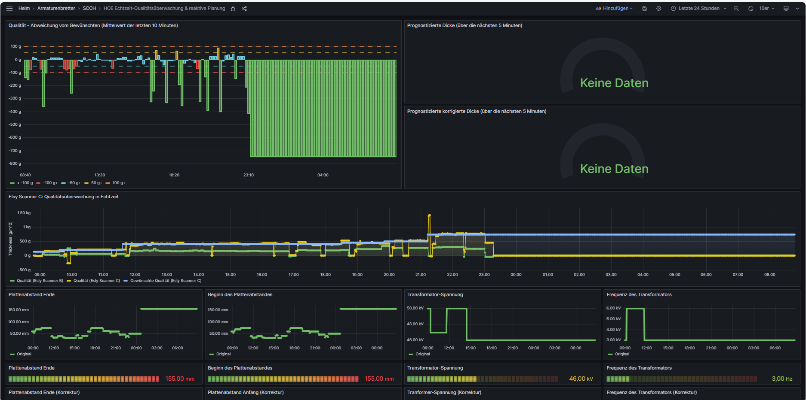
Reactive Optimization Monitoring
  Real-time quality and predictions monitoring
  Predictions are computed over the next 5min
  Recommendations are provided over the setpoints configuration
  Monitoring of overall performance improvement

Slide 43
HOE Training
June 2023
Question & answer
Question & answer

